Slide 1

LAB SQL 04 Database(s): salesshort Lab goals. Use inner joins with either your local MySQL Community Server instance or the on-premise MySQL server at Leeds. If you use your local MySQL Community Server instance, you will need to load the salesshort database into your local instance using the .sql file: S02 salesshort.sql. Remember to select ‘Don’t Limit’ to ensure your query results are not being limited to the first 10, 50, 100 rows, etc…
If you are still troubleshooting any part of the MySQL installation process and/or connection to the MySQL server instance at Leeds, please reference this PowerPoint. You can also use MySQL in phpMyAdmin as a demo.
MSBX-5405
Originally created by: Dr. Karina Hauser
Modified by: Keith Sparling

Slide 2
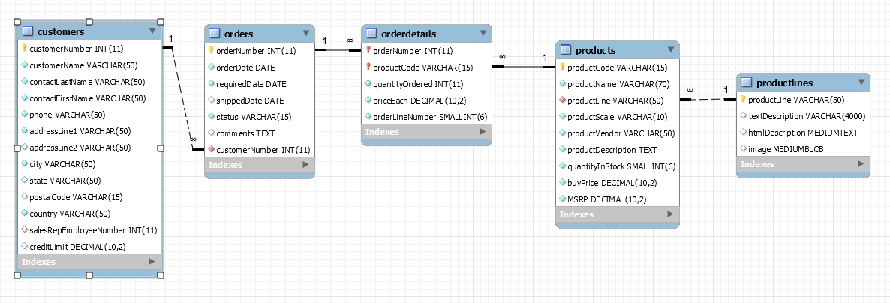
ER Diagram for SalesShort Database

Slide 3
LAB SQL 04 Save a .sql script labeled: lab04_”your IdentiKey” (for example: lab04_kesp5555)
Show all customers (number and name) and their cancelled orders only (order number, order date, and status).
Show the customerNumber, customerName, and each customer’s number of orders (i.e., count(orderNumber)). Group by the customerNumber. Order by the number of orders (most to least).
Show the product line, text description of the product line, and the number of products in the product line. Group by the product line. Order by the product line (A-Z).
Show all orders (order number, order date, status) with product code, product name, and sum(quantityOrdered). Group by the order number, then group by the product code. Order by the order number, then order by the product name.
Show all orders (order number, order date) with the ‘Total Revenue’ (quantityOrdered * priceEach) for the order. Group by the order number. Order by highest ‘Total Revenue’ to lowest.

Slide 4
LAB SQL 04 Save a .sql script labeled: lab04_”your IdentiKey” (for example: lab04_kesp5555)
Show the ‘Total Revenue’ by product (code and name). Show only orders that have been cancelled. Group by the product code. Order by ‘total revenue’ (highest to lowest).
Show the ‘Total Revenue’ by customer (customer number and name). Show only orders with a status of resolved or shipped. Group by the customer number. Order by ‘total revenue’ (highest to lowest).
Show all orders (number and date) with the product name, quantity ordered, msrp, price each, buy price, the difference between msrp and buy price (‘Potential Profit’), and the difference between price each and buy price (‘Actual Profit’). Show also the percentage of actual profit compared to potential profit (i.e., actual profit divided by the potential profit). Order by this percentage in descending order.

Slide 5
LAB SQL 04 Save a .sql script labeled: lab04_”your IdentiKey” (for example: lab04_kesp5555)
Show all customers (customer number and name), and total quantity they ordered per product (code and name). Group by the customer number, then group by the product code. Order by the customer number, then by the product code.
Show all United States customers (customer number and name), the products (code and name) the customer bought, the product line, and the product text description. Group by the customer number, then group by the product code. Order by the customer number, then by the product code.
Show ‘Total Revenue’ by country. Group by the country. Order by the highest to lowest ‘Total Revenue’. Show only shipped orders. Show only countries with a ‘total revenue’ greater than $500,000.

Slide 6
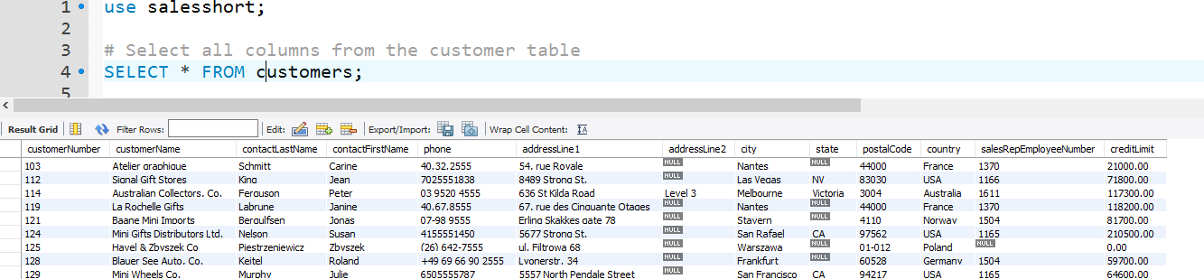
Submit the following:
One .sql file with your 11 SQL scripts.
OPTIONAL…a word document, PDF, or PowerPoint with screenshots of your SQL code and the first 10 - 20 lines of output for each of your 11 SQL scripts (i.e., select statements). Example:
This lab assignment will be reviewed by two peers, taking the average score from these two peer reviews, based on (1) the ability to execute/run each select statement and (2) the “recommended” output for each select statement.

Slide 7
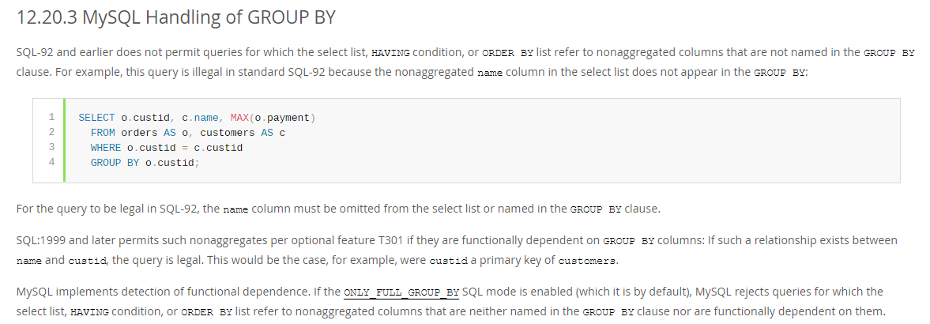
12.20.3 MySQL Handling of GROUP BY
From the MySQL 8.0 Reference Manual, this explains how MySQL works with "non-aggregates" to determine whether they have functional dependency with other columns used in the GROUP BY clause.

